Slide 1



New lesson
UNIT 12: LIFE ON OTHER PLANETS
LESSON : A CLOSER LOOK 1

Slide 2
I. Vocabulary
- Mercury (n)
: Sao Thủy
- Venus (n)
: Sao Kim
- Saturn (n)
: Sao Thổ
- Mars (n)
: Sao Hỏa
- Neptune (n)
: Sao Hải Vương
- Jupiter (n)
: Sao Mộc
- Uranus (n)
: Sao Thiên Vương

Slide 3



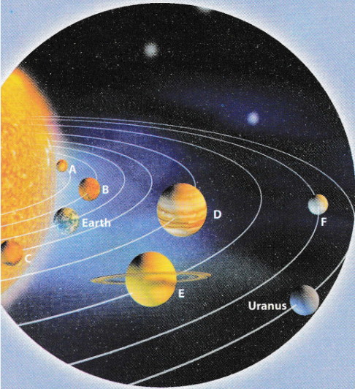

Mercury Venus Saturn
Mars Neptune Jupiter
A – Mercury
B – Venus
C – Mars
D – Jupiter
E – Saturn
F – Neptune
All Call
Student Demo

Slide 4
2. Now scan the passage and check your answers.
The planets in the solar system are named after the Roman Gods. Mercury is the smallest and closest planet to the Sun. It is named after the Roman God Mercury, who was the fast-flying messenger of the Gods, because it moves very fast. Venus is the second planet from the Sun. It is named after the Roman Goddess of love and beauty. Mars is the fourth planet from the Sun and the second smallest planet. It is named after the Roman God of war. The fifth planet from the Sun is Jupiter. It is also the largest planet. The Romans named the planet after the Roman God of thunder and lightning. Saturn is the sixth planet from the Sun and the second largest planet. It is named after the Roman God of agriculture. Neptune is the eighth planet from the Sun in the Solar System. It is named after the Roman God of the sea.
All Call
Student Demo

Slide 5

1. _________________
God of sea
Neptune
2. _________________
Saturn
God of agriculture
3. _________________
Mars
God of war
4. _________________
Jupiter
God of thunder and lighting
5. _________________
Venus
God of love and beauty
All Call
Student Demo

Slide 6

weight water beauty
wonder resource air
-ful -less
weightless waterless resourceful/ resourceless
airless beautiful wonderful
All Call
Student Demo

Slide 7

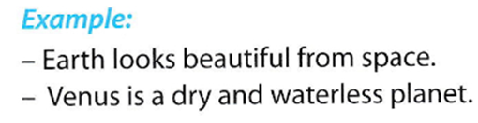
All Call
Pair
Student Demo

Slide 8

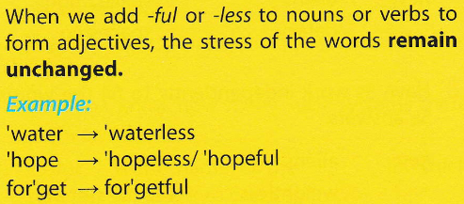
All Call
Student Demo

Slide 9

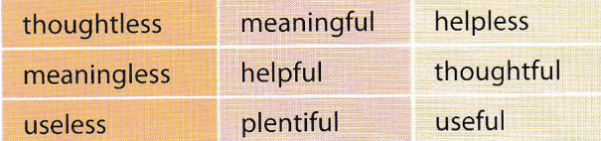
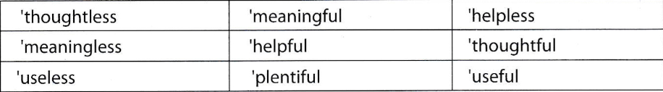

All Call
ABProgram + StartA + AV1
Student Demo

Slide 10
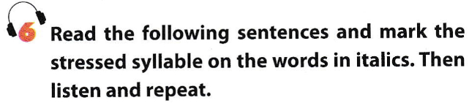
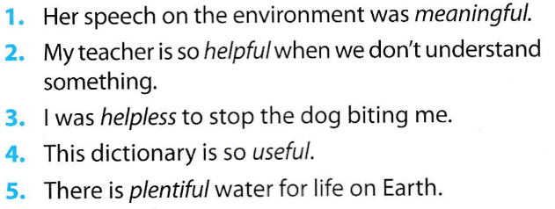
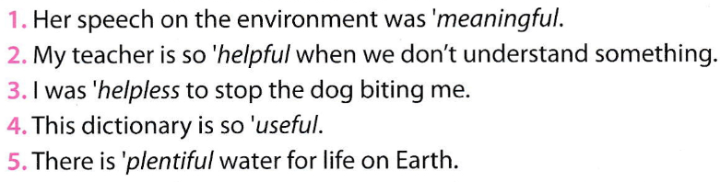
All Call
ABProgram + StartA + AV1
Student Demo

Slide 11
Homework
Learn by heart the new words.
Speak with your friends
Prepare for the next..

