Slide 1



New lesson
UNIT 12: LIFE ON OTHER PLANETS
LESSON 1: GETTING STARTED

Slide 2
LIFE ON OTHER PLANETS
- Can you tell me name of this planet where we are living?
How many planets in the solar system?
What planet in the solar system similar our Earth?

Slide 3
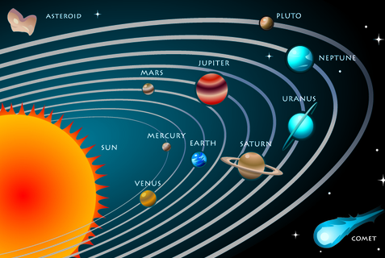
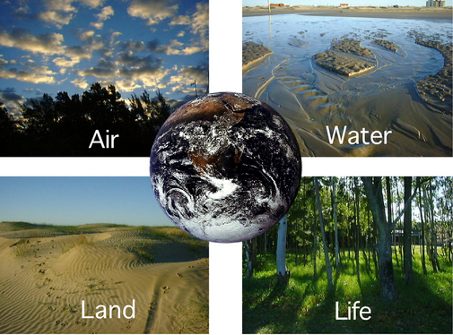
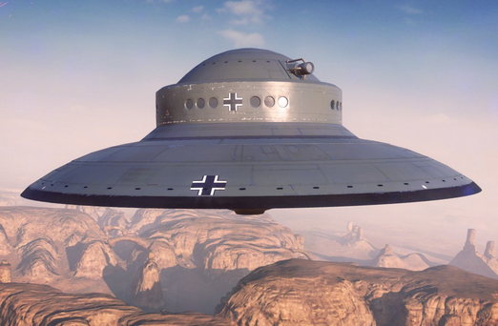
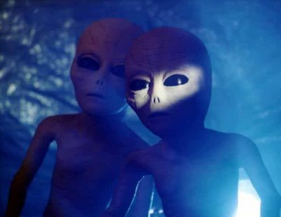
Solar system
Solar system
Earth
Unidentified Flying Object (UFO)
Aliens

Slide 4
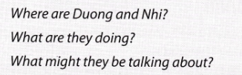
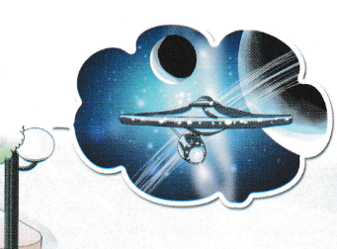
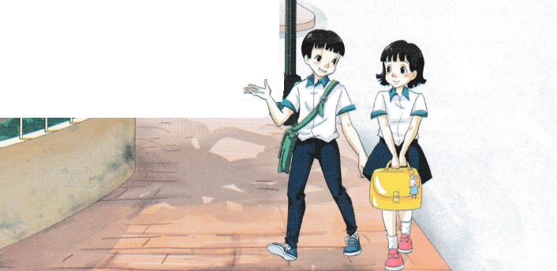
All Call
Student Demo

Slide 5

PERIOD 1st
UNIT 12: LIFE ON OTHER PLANETS
LESSON 1: GETTING STARTED

Slide 6
Vocabulary
1.
trek
(n)
: hành trình
2.
captain
(n)
: thuyền trưởng
3.
crew
(n)
: thủy thủ đoàn
4.
terrorist
(n)
: kẻ khủng bố
5.
alien
(n)
: người ngoài hành tinh
6.
space buggy
(n)
: xe vũ trụ
7.
galaxy
(n)
: dải ngân hà
8.
solar system
(n)
: hệ mặt trời

Slide 7



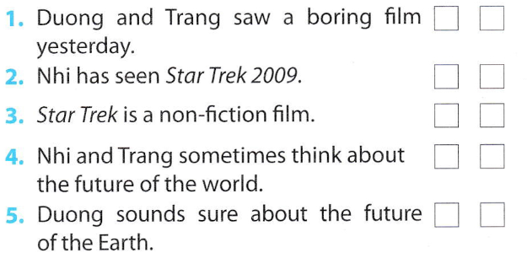
✓
✓
✓
✓
✓
All Call
Student Demo

Slide 8


James Kirk is the captain of the spaceship.
They went to Nibiru planet.
It happens in 2259.
It’s the name of the spaceship that the crew travels on.
He wants to destroy Earth.
All Call
Student Demo

Slide 9

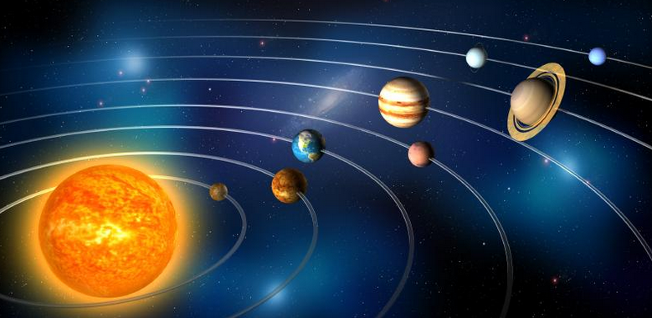
That’s funny, Trang also asked me what I thought would happen to Earth in the future.
I said I didn’t know but that Earth might be run by aliens!
All Call
Student Demo

Slide 10

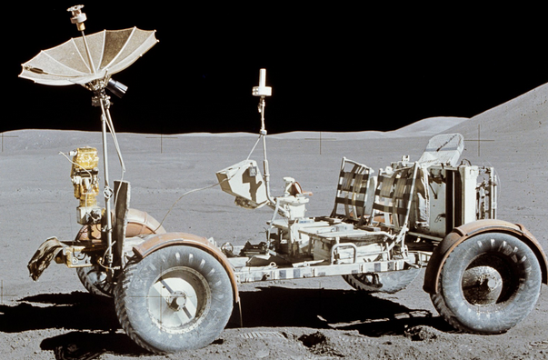

aliens space buggy galaxy planet
weight less solar system spaceship UFO
1.
Aliens
2.
Space buggy
All Call
ABProgram + StartA + AV1
Student Demo

Slide 11
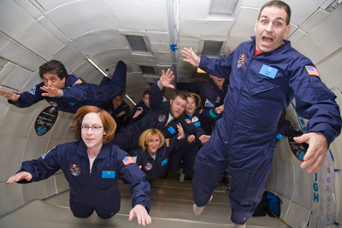
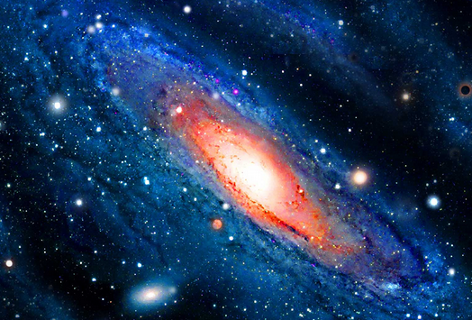
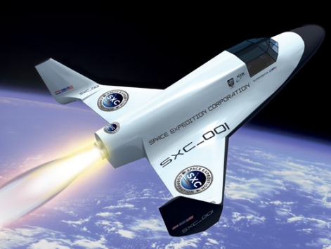
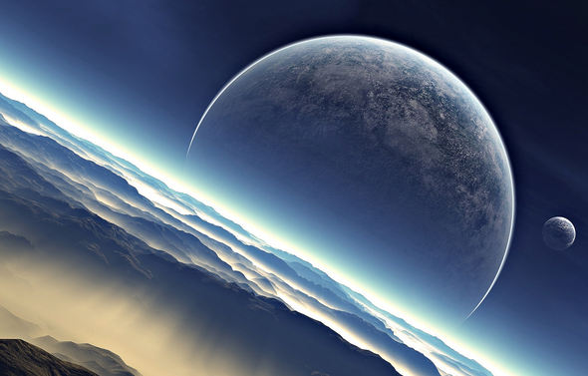
3.
UFO
4.
Weightless
5.
Galaxy
6.
Spaceship
7.
Planet
Solar system
8.

Slide 12
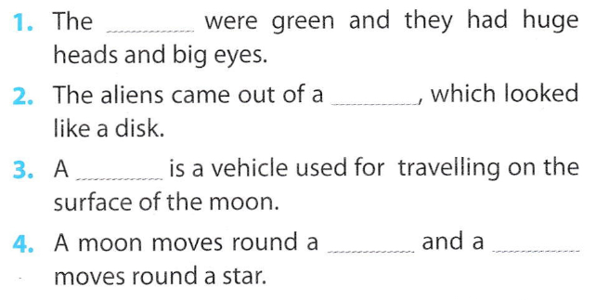
aliens space buggy galaxy planet
weight less solar system spaceship UFO
aliens
UFO
space buggy
planet planet
All Call
Student Demo

Slide 13
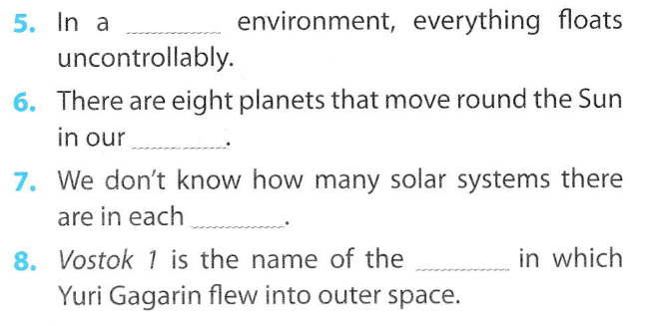
weightless
solar system
galaxy
spaceship

Slide 14


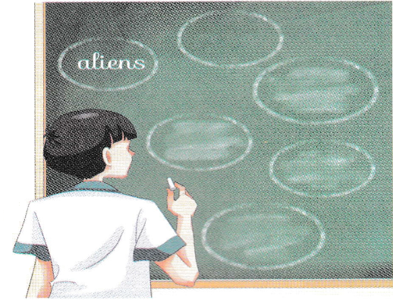
All Call
Student Demo

Slide 15
Homework
Learn by heart the new words.
Speak with your friends
Prepare for the next..

