Slide 1
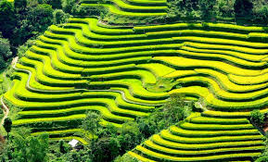
WELCOME
TO OUR CLASS

Slide 2
1
chatting
questions | T | F
1. There are more than 54 groups in Viet Nam
F
2. The H’mong don’t live in the Red river delta
t
3. Most ethnic group live mainly on hunting
F
4. The musical of the Tay is flute
F
5. The Viet live all over the country
t
6. All the groups have the same languages
F
7. The Tay live in a stilt house
t
8. The Odu has the smallest population
t
9. The Cham live mainly in southern provinces
F
10. The Viet work on terraced fields
F

Slide 3
2
Chatting
questions | T | F
1. The Khmer live mainly in southern provinces
t
2. The Muong live a nomadic life
F
3. We can see terraced fields in Red river Delta
F
4. “Hat then” belongs to the H’mong
F
5. Each ethnic group has their own costumes
t
6. The H’mong in Sapa speak English well
t
7. “Gong – cång, chiªng” belongs to the Van Kieu
F
8. The Viet don’t live in a stilt house
t
9. Ethnic groups never go hunting
F
10. Most ethnic groups go to open-air markets
t

Slide 4
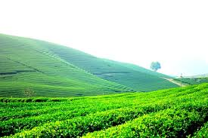
UNIT 3
PEOPLES IN VIET NAM
Lesson 5: Skill 1

Slide 5
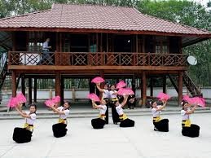
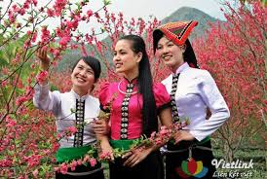
I- reading
The thai

Slide 6
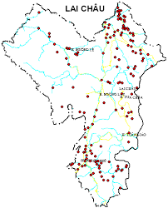
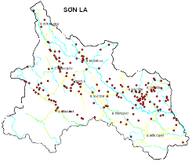
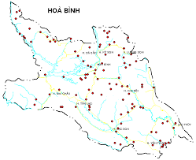
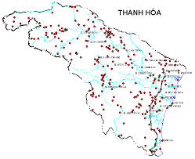
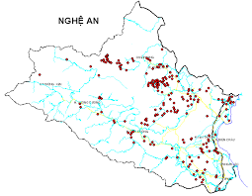
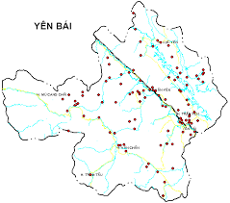

Slide 7
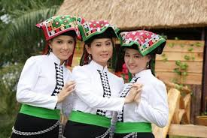
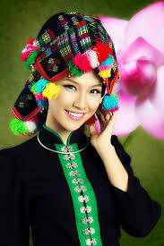
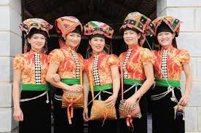
There are three kinds of Thai people
The white Thai
The black Thai
The red Thai

Slide 8
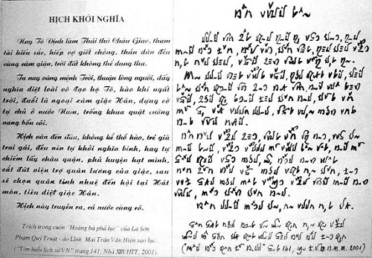
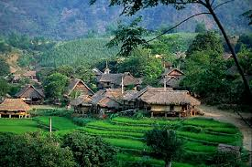
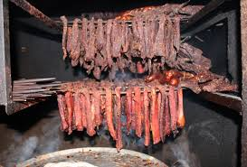
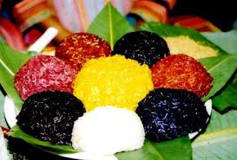
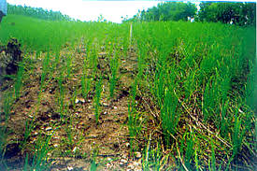
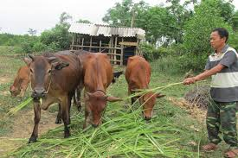
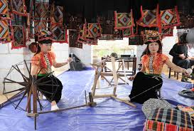
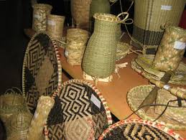
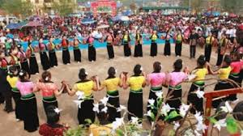
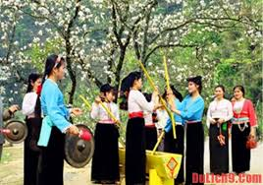
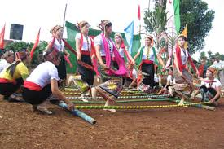
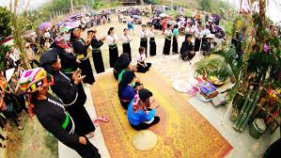
Main features
Language
Housing
Special food
Production activities
Festivals and ceremonies

Slide 9
What do you know about the Thai?
features | information
1. Population
2. Regions
3. Language
4. Housing
5. Main jobs
6. Main products
7. Costumes
8. Festivals
1,500,000
Lai Chau, Son La, Yen Bai, Nghe An…
Tay-Thai group
Stilt houses
Farming, cattle raising, cloth weaving
Bamboo items, cloth
Short blouse, long skirt, ornaments
Festivals with traditional games

Slide 10
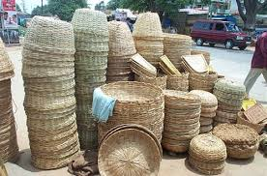
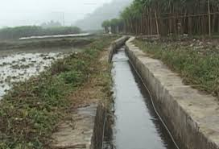
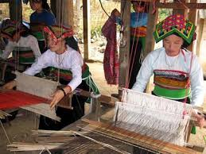
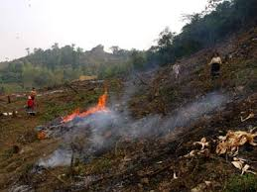

Slide 11
Read the text then complete these sentences
with no more than ONE word
0. The Thai_______________ belongs to the Tay-Thai group
1. They get water for their fields from________________
2. The Thai earn their living from_______________ rice, raising
cattle, weaving cloth or making items from_______________
3. The Thai live in _________________ with 40 to 50 houses each
4. Their________________ consists of a short blouse, a long skirt
and ornaments
5. “Xoe” is the traditional______________ of the Thai
6. The Thai worship their________________
language
canals
growing
bamboo
villages
costume
dance
ancestors

Slide 12
Make a summary about the Thai?
features | information
1. Population
2. Regions
3. Language
4. Housing
5. Main jobs
6. Main products
7. Costumes
8. Festivals
1,500,000
Lai Chau, Son La, Yen Bai, Nghe An…
Tay-Thai group
Stilt houses
Farming, cattle raising, cloth weaving
Bamboo items, cloth
Short blouse, long skirt, ornaments
Festivals with traditional games

Slide 13
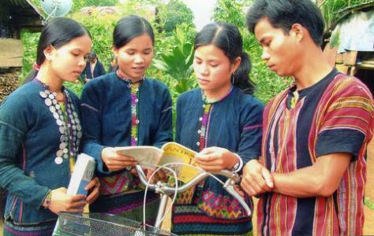
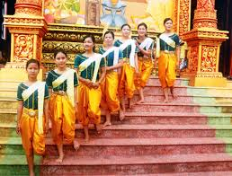
II- speaking
The bru-van kieu
The Khmer
Population: 74,500
Regions: Quang Binh, Quang Tri, Hue
Language: Mon- Khmer group
Productions: growing rice on terraced fields,
raising cattle and poultry
Festivals: Festival before sowing seeds
Population: 1,260,000
Regions: Mekong Delta
Language: Mon- Khmer group
Productions: growing rice, making sugar,
raising cattle
Festivals: Chaul Chnam Thmay
Greeting the Moon

Slide 14
HOMEWORK
Learn new words by heart.
Write a passage (100-120 words) about a people you know

