Slide 1
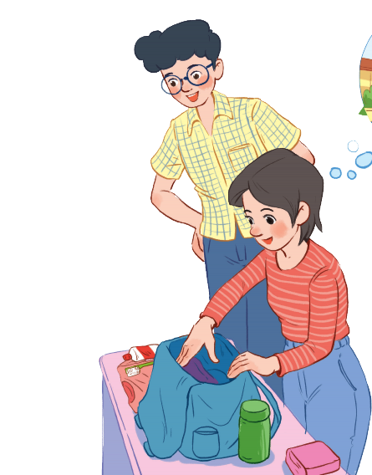
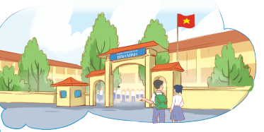
Memory game
Remember the details in
30 seconds

Slide 2
Answer the questions
1. How many people can you see?
2. What is the girl doing?
3. What does she put inside her bag?
4. Where are they going?
Phuc
There are 2 people.
She is preparing her bag.
Binh Minh
Lower Secondary school
Clothes, bottle of water, etc.
Mi
They are going to a school.

Slide 3
Unit 6 A visit to a school
Lesson 1: Getting Started

Slide 4
NEW WORDS
Lower secondary school
/ˈləʊər ˈsekəndrɪ skuːl/
trường trung học cơ sở

Slide 5
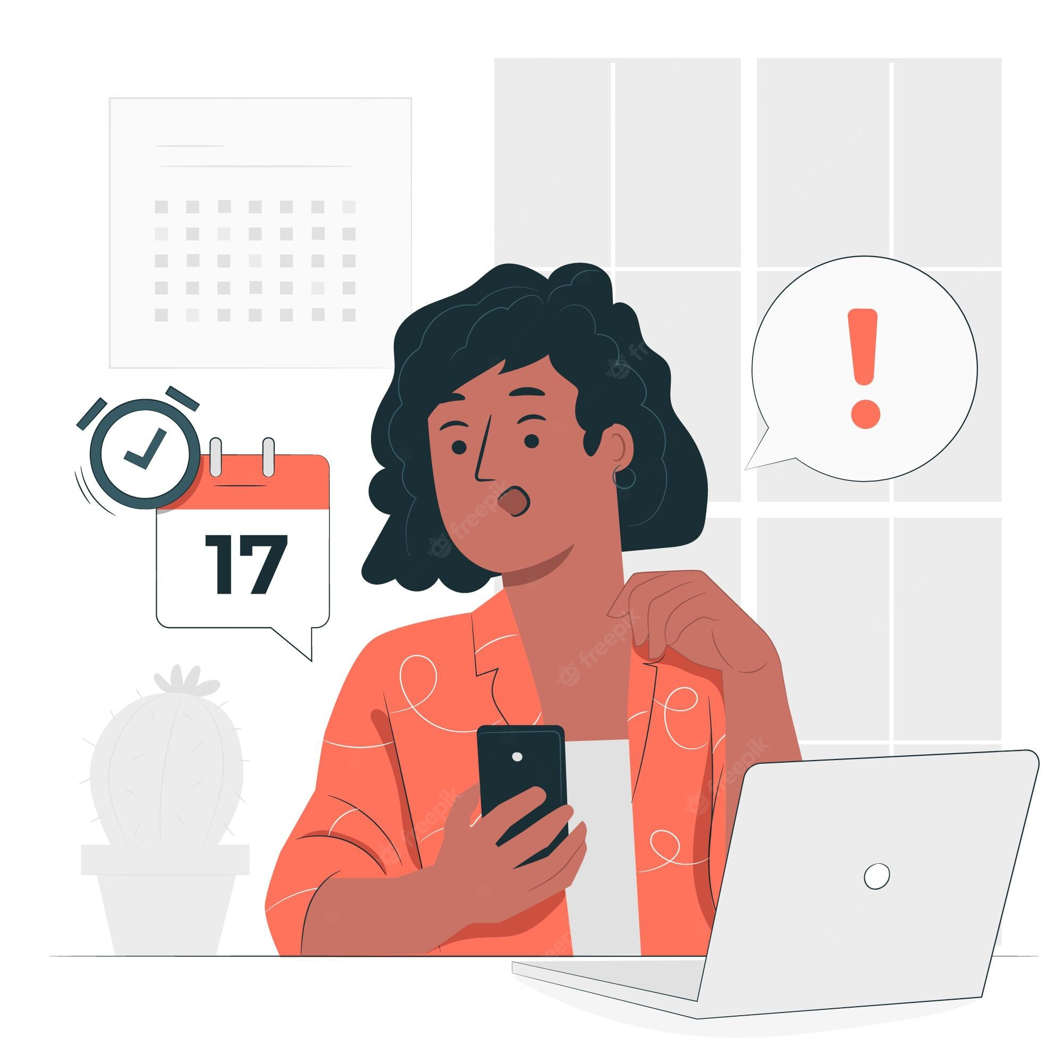
NEW WORDS
remind (v)
/rɪˈmaɪnd/
gợi nhớ, nhắc nhở

Slide 6
1
Listen and read
1. What are they talking about?
A. A visit to a computer room. B. A visit to a school. C. A visit to a school library.
2. Who is going to visit the school? A. Mi and her teacher. B. Mi and her classmates. C. Mi, her teacher and her classmates.
3. Where is the school? A. In the city. B. In the countryside. C. In Phong’s neighbourhood.
4. When are they going?
A. In the morning. B. In the afternoon. C. At noon.
Phong: What are you doing, Mi? Mi: I’m preparing to visit Binh Minh Lower Secondary School. Phong: Sounds great! I think that’s one of the best schools in my neighbourhood. Who is going with you and when? Mi: My teacher and my classmates. We’re going in the afternoon. Phong: I see. What will you do there? Mi: Well, I think we’ll visit the school library, the computer room, and the gym. We’ll meet the students and share ideas for a project in our English class. Phong: That’s interesting. What else will you do there? Mi: We’ll meet the members of their Go Green Club and take photos of the school. Phong: Fantastic! so don’t forget to take your camera. Mi: I almost forgot. Thanks for reminding me.

Slide 7
1
Check your answer
1. What are they talking about?
A. A visit to a computer room. B. A visit to a school. C. A visit to a school library.
Phong: What are you doing, Mi? Mi: I’m preparing to visit Binh Minh Lower Secondary School.
Phong: What are you doing, Mi? Mi: I’m preparing to visit Binh Minh Lower Secondary School.
2. Who is going to visit the school? A. Mi and her teacher. B. Mi and her classmates. C. Mi, her teacher and her classmates.
Phong: Who is going with you and when? Mi: My teacher and my classmates. We’re going in the afternoon.
Phong: Who is going with you and when? Mi: My teacher and my classmates. We’re going in the afternoon.

Slide 8
1
Check your answer
3. Where is the school? A. In the city. B. In the countryside. C. In Phong’s neighbourhood.
Phong: Sounds great! I think that’s one of the best schools in my neighbourhood. Who is going with you and when?
Phong: Sounds great! I think that’s one of the best schools in my neighbourhood. Who is going with you and when?
4. When are they going?
A. In the morning. B. In the afternoon. C. At noon.
Phong: Who is going with you and when? Mi: My teacher and my classmates. We’re going in the afternoon.
Phong: Who is going with you and when? Mi: My teacher and my classmates. We’re going in the afternoon.

Slide 9
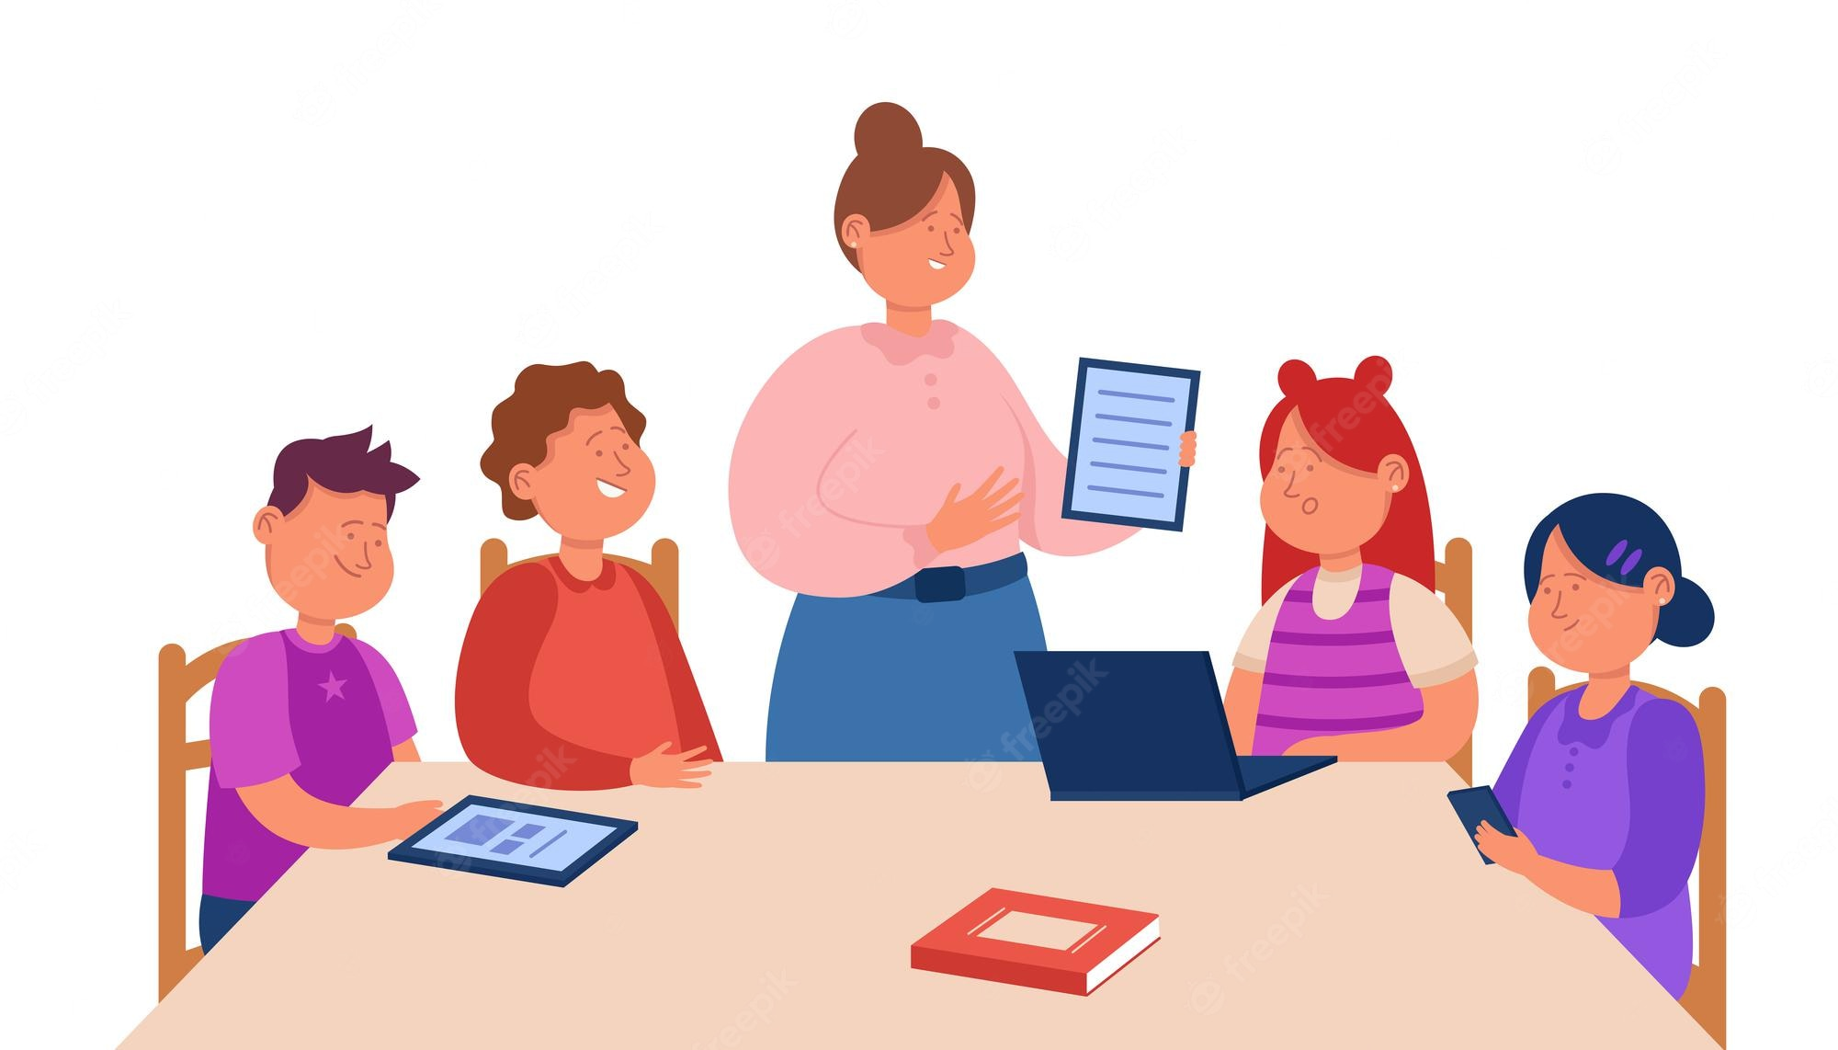
Pelmanism
Let’s play a game to discover about new school!

Slide 10
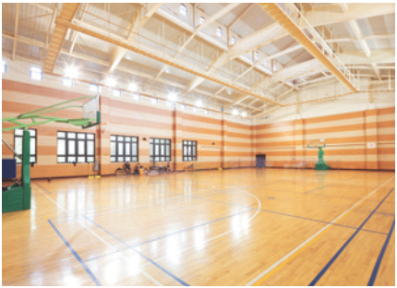
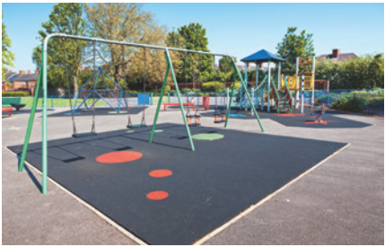
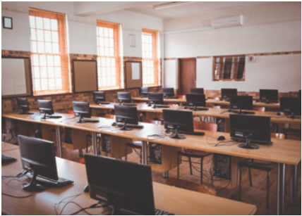
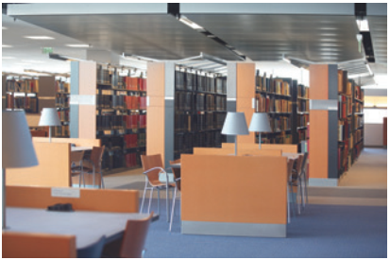
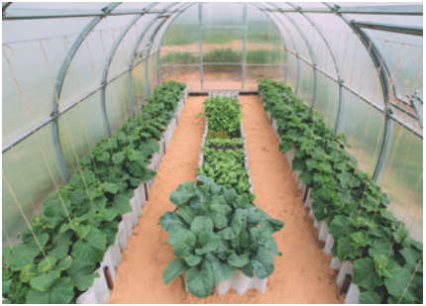
Pelmanism
How to play:
Choose one yellow card and orange card to find a pair
Computer room
school
library
Play-ground
school garden
gym
1
2
3
4
5
A
B
C
D
E
Notes:
Hướng dẫn trò chơi: Các thầy cô bấm vào chữ và tranh, nếu đúng thì để nguyên, nếu sai chỉ cần bấm lại 1 lần nữa để che lại.

Slide 11
4
Complete the sentences with the words and phrases.
computer room
playground
gym
school library
school garden
1. The school _______________ is very small, so not many children can play in it.
2. We learn how to use the Internet in the _______________ twice a week.
3. They have school meetings in the _______________ when it rains.
4. There are a lot of books, magazines, and newspapers in the _______________.
5. Our class usually waters the vegetables in the _______________ on Friday afternoons.
playground
computer room
gym
school library
school garden

Slide 12
4
Complete the sentences with the words and phrases.
Subject | Time | Place
Maths | 8 a.m. Monday, Tuesday, Friday | Classroom (room 302)
Biology | 9 a.m. Thursday | Science lab
Information Technology | 2 p.m. Wednesday | Computer room
Physical Education | 3 p.m. Monday, Thursday | School gym
History | 3:30 p.m. Tuesday | School library
Example: A: When does Nick have maths? B: At 8 a.m. on Monday, Tuesday, and Friday. A: And where does he have it? B: In his classroom, room 302.

Slide 13
RECAP
What subject does Nick have on Monday and Thursdday
A. Maths
B. Information Technology
C. History
D. Biology
E. Physcial Education

Slide 14
RECAP
Which is not belong to topic “A day to a school”
gym
playground
garden
Secondary school
camera
camera
library

Slide 15
Great work!
See you next time

