Slide 1
UNIT 2. MY HOUSE
Lesson 5: Skills 1

Slide 2
Reading
Speaking
Look at the text. Answer the questions.
Create a new room for the hotel. Draw a plan for the room.
Read the text again and answer the questions.
Show your plan to your partner and describe it.
Circle the things in the Tiger Room.

Slide 3
UNIT 2. MY HOUSE
Lesson 5: Skills 1
I. Reading

Slide 4
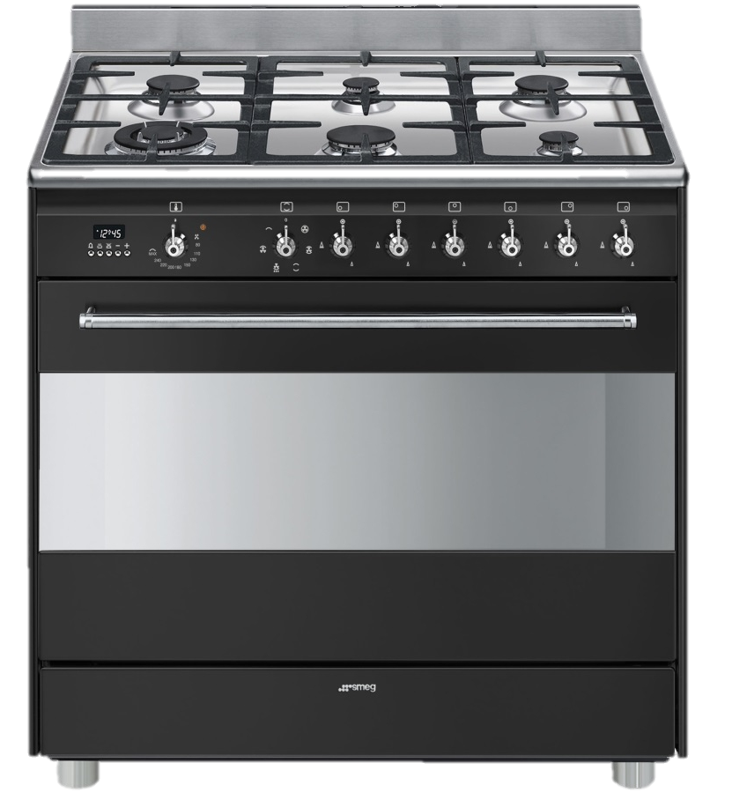
UNIT 2. MY HOUSE
Lesson 5: Skills 1
*Vocabulary
shelf /ʃelf/
cooker /ˈkʊkər/

Slide 5
UNIT 2. MY HOUSE
Lesson 5: Skills 1
Reading
* Vocabulary
1 | email | (n) | thư điện tử | /ˈiːmeɪl/
2 | crazy | (adj) | kì dị, lạ thường | /ˈkreɪzi/ (adj)
3 | strange | (adj) | kì lạ | /streɪndʒ/
4 | cooker | (n) | bếp, nồi cơm điện | /ˈkʊkər/
5 | shelf shelves | (n) (plural) | kệ, giá | /ʃelf/

Slide 6
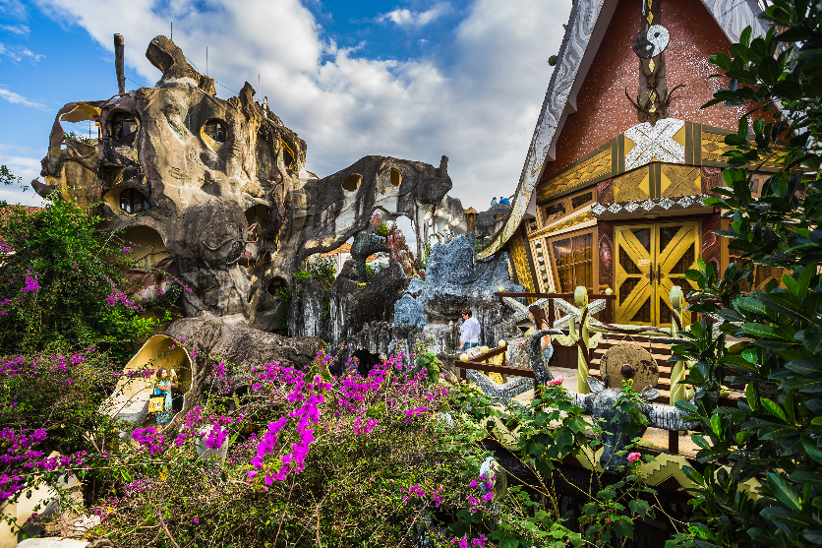
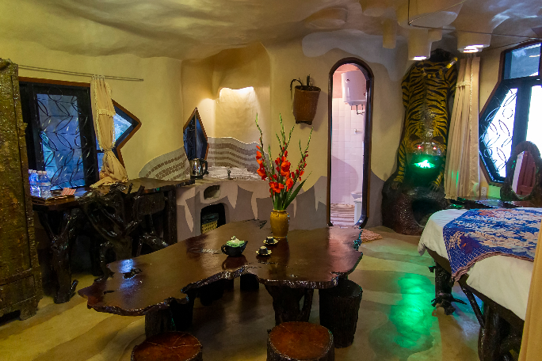
Look at the text. Answer the questions.
Reading skill: Predicting
Predicting makes reading easy.
Before reading, look at the pictures, design and title.
Decide what the text is about.
Think about what you know about the topic.

Slide 7
To: phong@webmail.com; mi@webmail.com
Subject: A room at the Crazy House Hotel
Hi Phong and Mi,
How are you? I’m in Da Lat with my parents. We’re staying at the Crazy House Hotel. Wow! It really is crazy. There are ten rooms in the hotel.
There’s a Kangaroo Room, an Eagle Room, and even an Ant Room. I’m staying in the Tiger Room. It’s called the Tiger Room because there’s a big tiger on the wall.
The tiger is between the bathroom door and the window. The bed is next to the window, but the window is a strange shape. I put my bag under the bed. There’s a lamp, a wardrobe and a desk.
You should stay here when you visit Da Lat. It’s great.
See you soon!
Nick

Slide 8
1.
Is it an email or a letter?
2.
What is the text about?
It's an email.
The text is about Nick's room at the Crazy House Hotel.
To: phong@webmail.com; mi@webmail.com
To: phong@webmail.com; mi@webmail.com
Subject: A room at the Crazy House Hotel
Subject: A room at the Crazy House Hotel
Hi Phong and Mi,
How are you? I’m in Da Lat with my parents. We’re staying at the Crazy House Hotel. Wow! It really is crazy. There are ten rooms in the hotel.
There’s a Kangaroo Room, an Eagle Room, and even an Ant Room. I’m staying in the Tiger Room. It’s called the Tiger Room because there’s a big tiger on the wall.
The tiger is between the bathroom door and the window. The bed is next to the window, but the window is a strange shape. I put my bag under the bed. There’s a lamp, a wardrobe and a desk.
You should stay here when you visit Da Lat. It’s great.
See you soon!
Nick

Slide 9
Read the text again and answer the questions.
1.
Who is Nick in Da Lat with?
He's in Da Lat with his parents.
2.
How many rooms are there in the hotel?
There are ten rooms.
3.
Why is the room called the Tiger Room?
Because there's a big tiger on the wall.
4.
Where is Nick’s bag?
It's under the bed.
I’m in Da Lat with my parents.
It’s called the Tiger Room because there’s a big tiger on the wall.
I put my bag under the bed.
There are ten rooms in the hotel.

Slide 10
Circle the things in the Tiger Room.
a window
a wardrobe
a cooker
a cupboard
a shelf
a lamp
a desk
a tiger

Slide 11
UNIT 2. MY HOUSE
Lesson 5: Skills 1
II. Speaking

Slide 12
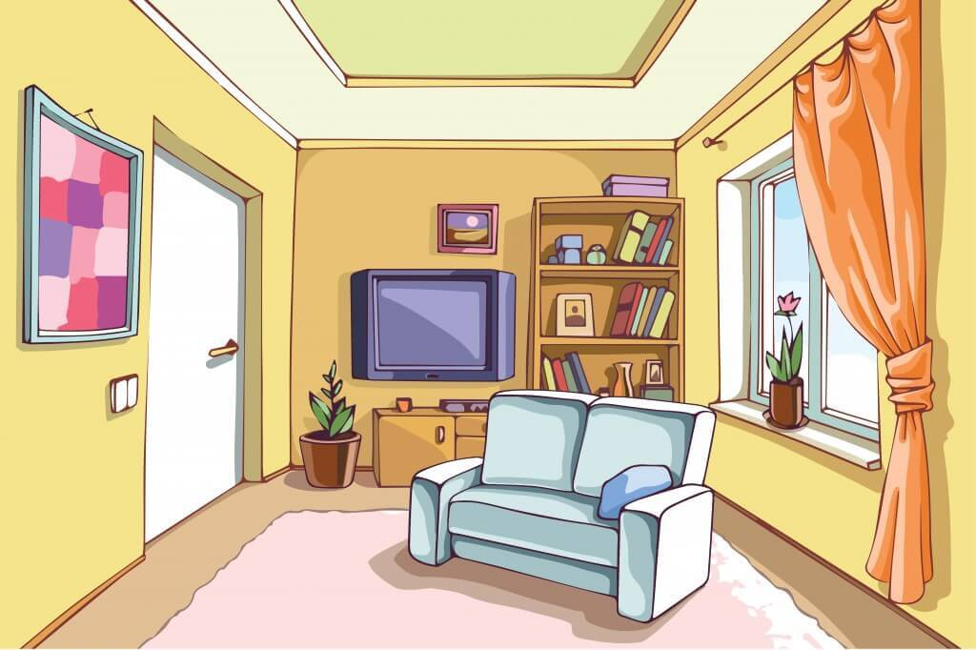
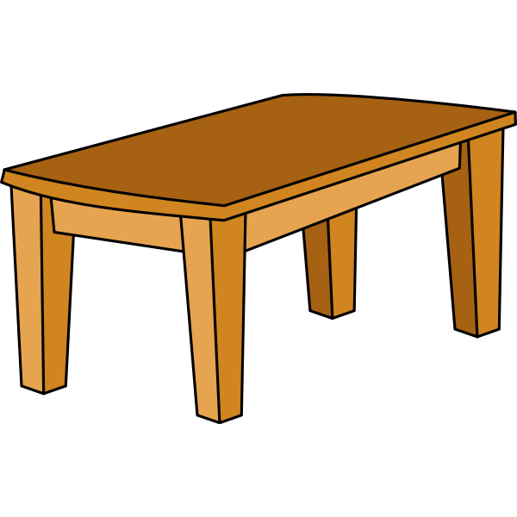
Create a new room for the hotel. Draw a plan for the room.

Slide 13
Show your plan to your partner and describe it.
Example:
This is the Shark Room. There’s a big shark at the door. There’s a table and a sofa in `the room ...
This is the ……………Room. There’s…………………………...
There are………………………..

Slide 14
III. Wrap- up
UNIT 2
SKILLS 1
READING
SPEAKING
A room at the Crazy house hotel
A room

Slide 15
IV. Homework
Learn by heart the vocabulary
Do exercises in Workbook
Prepare: Unit 2 – Skills 2

