Slide 1

WELLCOME All THE TEACHERS AND MY LOVELY STUDENTS
Teacher : Do Thi Hoa
Class: 3A2
Unit 18: playing and doing
Lesson 3- part ( 4,5,6)

Slide 2
Wellcome all the teachers and my lovely students

Slide 3

Warm-up and review

Slide 4


Slide 5



18
Period 123

Slide 6
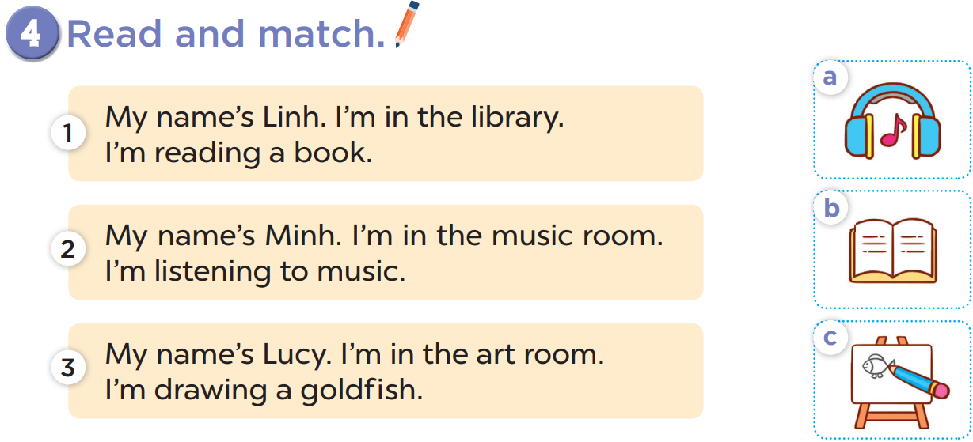

Slide 7




Slide 10

Look and answer the questions.

Slide 11
Play game: “Sentence puzzle”

Slide 12



Game: Sentence puzzle
Linh.
name
My
is
My
name
is
Linh.
Notes:
Wait for the clock to count down.
Click anywhere to show the answer.

Slide 13
Game: Sentence puzzle
music.
listening
I’m
to
I’m
listening
to
music.
Notes:
Wait for the clock to count down.
Click anywhere to show the answer.

Slide 14
Game: Sentence puzzle
music room.
in
I’m
the
I’m
in
the
music room.
Notes:
Wait for the clock to count down.
Click anywhere to show the answer.

Slide 15
Game: Sentence puzzle
book.
reading
I’m
a
I’m
reading
a
book.
Notes:
Wait for the clock to count down.
Click anywhere to show the answer.

Slide 16
Game: Sentence puzzle
art room.
in
I’m
the
I’m
in
the
art room.
Notes:
Wait for the clock to count down.
Click anywhere to show the answer.

Slide 17
Game: Sentence puzzle
picture.
drawing
I’m
a
I’m
drawing
a
picture.
Notes:
Wait for the clock to count down.
Click anywhere to show the answer.

Slide 18
Look and say

Slide 19

Peter

Slide 20
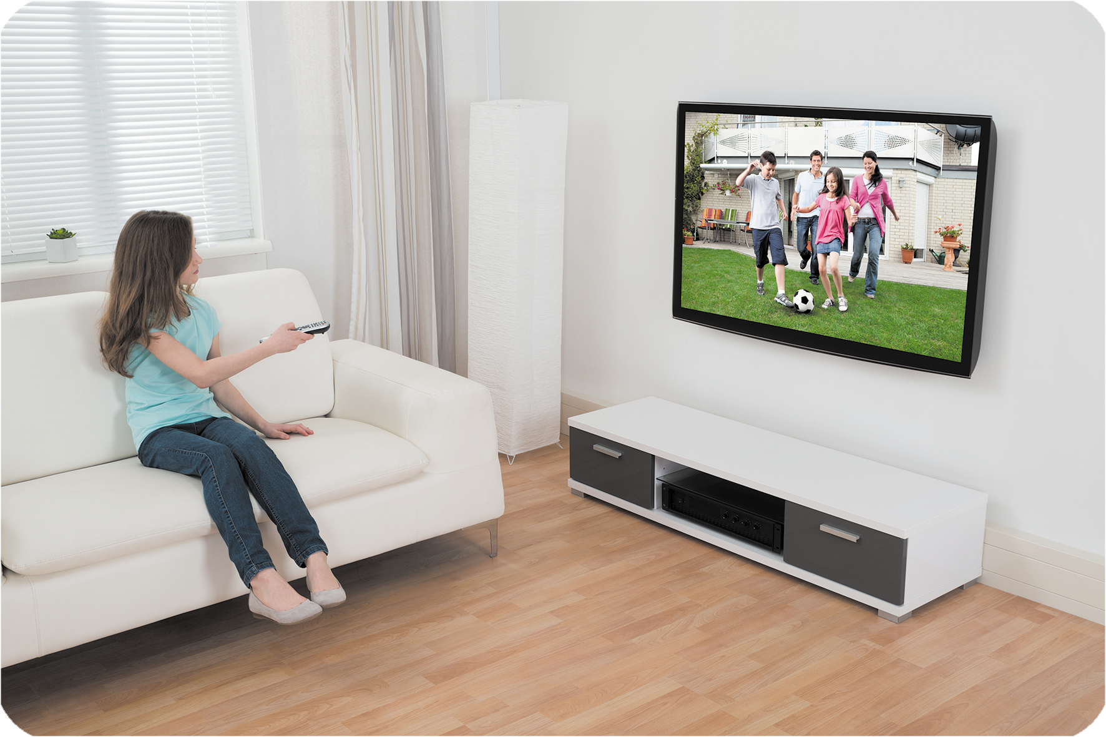
Mary

Slide 21
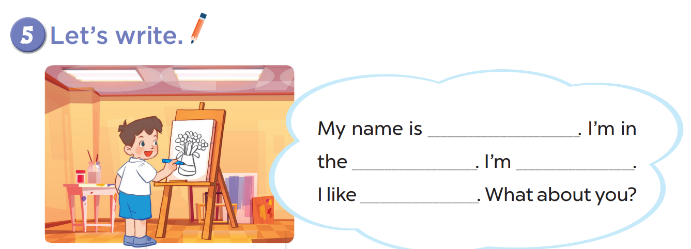

Slide 22



Slide 23
Minh
drawing a picture
art room
drawing

Slide 24
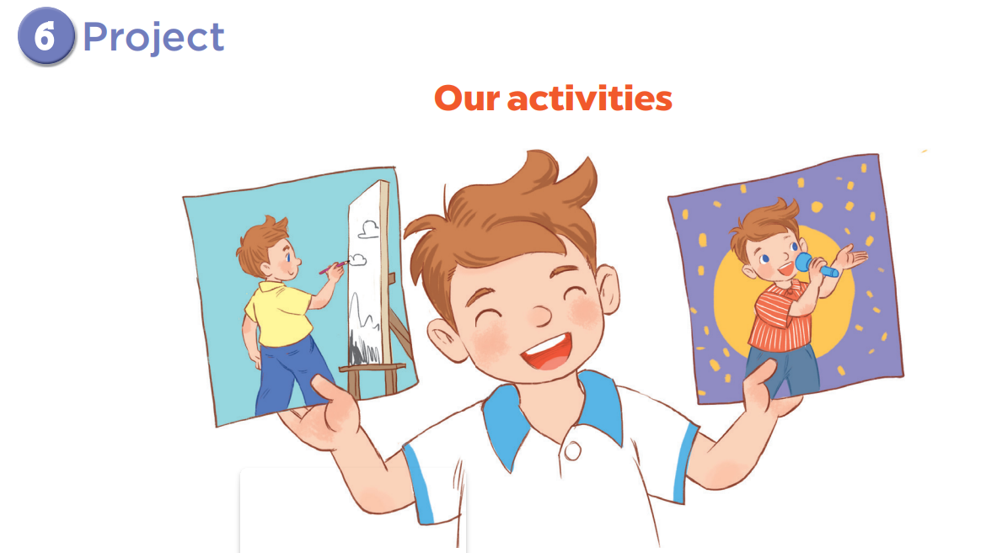

Slide 25

60
59
58
57
56
55
54
53
52
51
50
49
48
47
46
45
44
43
42
41
40
39
38
37
36
35
34
33
32
31
30
29
28
27
26
25
24
23
22
21
20
19
18
17
16
15
14
13
12
11
10
09
08
07
06
05
04
03
02
01
Hết giờ
Bắt đầu

Slide 26
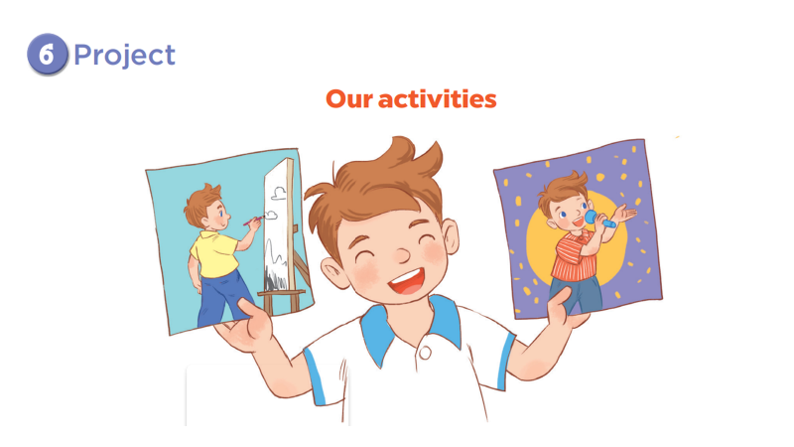


Slide 27
The end

