Slide 1
UNIT 1: MY NEW SCHOOL
LESSON 3
A CLOSER LOOK 2

Slide 2
Grammar
The present simple
Adverbs of frequency
Fill the blanks with usually, sometimes or never.
Choose the correct answer A, B, or C.
Choose the correct answer A or B to complete each sentence.
Miss Nguyet is interviewing Duy for the school newsletter. Write the correct form of the verbs.
Work in pairs. Make questions, and then interview your partner.

Slide 3
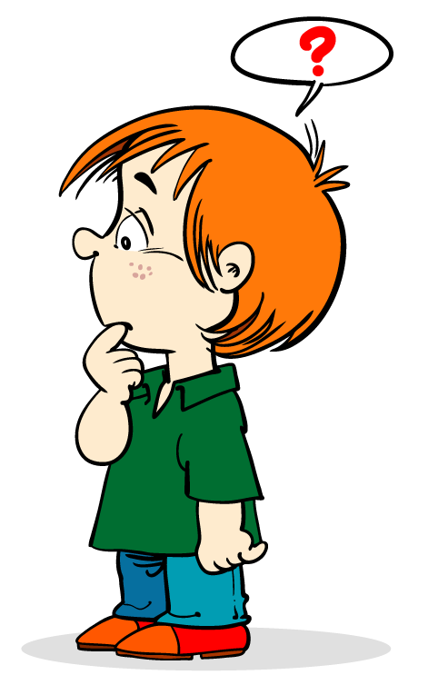
D
A
I
L
Y
WARM UP
R
O
U
T
I
N
E

Slide 4
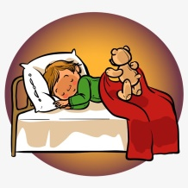
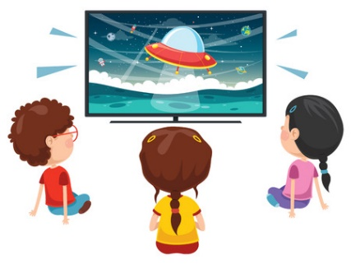
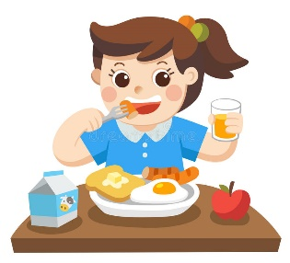
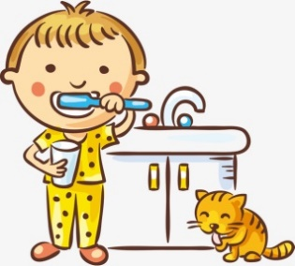
go to school
go to bed
daily routine
watch TV
do homework
have breakfast
brush teeth

Slide 5
UNIT 1. MY NEW SCHOOL
Lesson 3: A Closer look 2
I. The present simple
(Thì hiện tại đơn)

Slide 6
I. Grammar:
The present simple
We use the present simple to talk about actions or events that often happen, or are fixed.
Example:
We usually go to school by bus.
I don’t like school lunch very much.

Slide 7
I go to school at 6 o clock.
I go to school at 6 o clock.
……….....goes to school at ……………
The present simple verbs with he / she / it need an s / es.

Slide 8
I. The present simple (Thì hiện tại đơn)
Use (cách sử dụng)
Diễn tả thói quen, hành động thường xuyên xảy ra
Sự việc, lịch trình cố định.

Slide 9
I. The present simple (Thì hiện tại đơn)
2. Form (cấu trúc)
Verb
(+) I/You/We/They/ danh từ số nhiều + V
(-) I/You/We/They/ danh từ số nhiều + don't/ do not + V
(?) Do + l/you/we/they/ danh từ số nhiều + V ?
- Yes, I /you/we/they/ danh từ số nhiều + do.
- No, I / you/we/they/ danh từ số nhiều + don't.
(+) He/She/It/ danh từ số ít + V-s/V-es (works/ goes)
(-) He/She/It/ danh từ số ít + doesn't + V
(?) Does he/she/it/ danh từ số ít + V ?
- Yes, he/she/it/ danh từ số ít + does.
- No, he/she/it/ danh từ số ít + doesn't.

Slide 10
Choose the correct answer A, B, or C.
1.
We new subjects for this school year.
A.
B.
has
C.
having
have - has
have
2.
Duy to school every day.
A.
cycling
B.
cycle
C.
cycles
3.
My new school in the centre of the village.
B.
C.
doesn’t
A.
not
isn’t
4.
I live near here. Where live?
A.
B.
you
do you
C.
are you
5.
My friend has a sister, but she a brother.
A.
not has
doesn’t have
B.
don’t have
C.

Slide 11
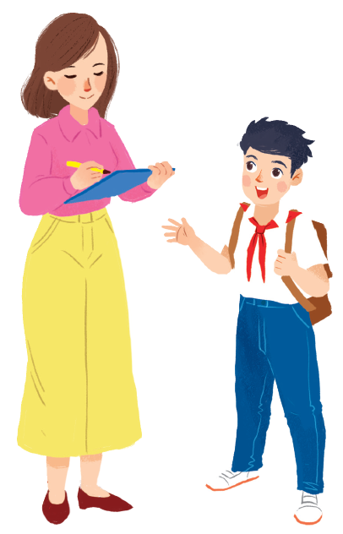
Miss Nguyet is interviewing Duy for the school newsletter. Write the correct form of the verbs.
Miss Nguyet: Tell us about your new school, Duy.
has
Duy: Sure! My school (1.have) a large playground.
Do
have
Mis Nguyet: you (2. have) any new friends?
like
Duy: Yes. And I (3. like) my new friends, Vy and Phong.
Does
walk
Mis Nguyet: Vy (4. walk) to school with you?
ride
Duy: Well, we often (5. ride) our bicycles to school.
Mis Nguyet: What time do you go home?
Duy: I (6. go) home at 4 p.m. every day.
go
Mis Nguyet: Thank you!

Slide 12
UNIT 1. MY NEW SCHOOL
Lesson 3: A Closer look 2
II. Adverbs of frequency
(Trạng từ chỉ tần suất)

Slide 13
II. Adverbs of frequency
(Trạng từ chỉ tần suất)
We use adverbs of frequency to show how often something happens.
We often use them with the present simple.
We usually place the adverb of frequency before the main verb.
Example:
Tom usually takes the bus to school.
They don’t often go to the cinema.

Slide 14
II. Adverbs of frequency
(Trạng từ chỉ tần suất)
Trạng từ chỉ tần suất đứng trước động từ thường.
Example:
Tom usually takes the bus to school.
They don’t often go to the cinema.

Slide 15
Choose the correct answer A or B to complete each sentence.
1.
I late on Saturdays.
A.
get up usually
B.
usually get up
2.
My mum to work late.
A.
rarely goes
B.
goes rarely
3.
at weekends?
A.
Do you often travel
B.
Often do you travel
4.
What kind of music ?
A.
Usually does Susan listen to
B.
does Susan usually listen to?
5.
When go on holiday each year?
A.
do you usually
B.
you usually

Slide 16
Fill the blanks with usually, sometimes or never.
1.
always
2.
usually
3.
sometimes
4.
rarely
5.
never

Slide 17
I usually play badminton with my dad.
1. I .................. play badminton with my dad.
2. I usually …………………………………………………...
……………………………………….................................
1.
always
Write a sentence with one of these adverbs.
2.
usually
3.
sometimes
1.
4.
rarely
2.
5.
never
3.

Slide 18
Choose the correct word to complete the sentences.
1.
you / often / ride your bicycle / to school
Do you often ride your bicycle to school?
2.
you / sometimes / study / in the school libraby
Do you sometimes study in the school library?
3.
you / like / your new school
Do you like your new school?
4.
your friends / always / go to school / with you
Do your friends always go to school with you?
5.
you / usually / do homework / after school
Do you usually do homework after school?

Slide 19
III. Wrap- up
- Use: actions or events that often happen, or are fixed.
Form
(+) She/he/it + V-s/V-es
(-) She/he/it + doesn’t + V
(?) Does + she/he/it + V?
The
present simple
always, usually, often, sometimes, rarely, never
Adverbs of frequency

Slide 20
IV. Homework
Do exercise 1, 2, 3, 4
(Workbook, page 4,5)
Prepare: Unit 1 – Communication

